Slide 1


STOCK MARKET ANALYSIS
October 2024

Slide 2


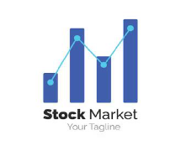
Ministry of Communications and Information Technology Digital Egypt Pioneers Initiative) DEPI)
Graduation Project Document
Analyzing Key Drivers of the American Stock Market 2013 -2018
Supervisor
ENG/ Marwan Mokhtar

Slide 3
Team Members:
Maha Fathy Ghoneim
Gehad Abdulhamied Soliman
Dina Khaled Helal
Ayat Abdulhamied Abulkhair

Slide 4
Introduction
This project analyzes S&P 500 stock market trends, utilizing six datasets to explore sector performance, price volatility, and trading activity. Through SQL queries and Power BI visualizations, the analysis provides actionable insights for investors, highlighting key dynamics in sectors like technology, healthcare, and energy.

Slide 5
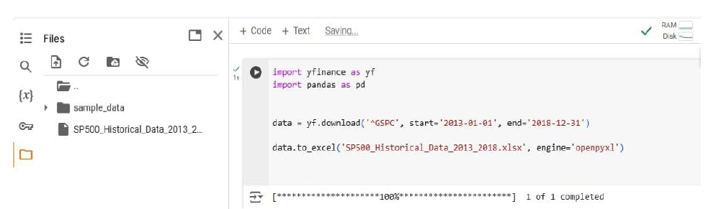
Data Collection
Sources
Yahoo Finance: SP500 Historical Data
Kaggle: Stock Fact
Wikipedia: Security
EXLE Files: Fact Financial, GIO-Fact

Slide 6
Data Overview
Stock Fact: Contains data on stock prices, volume, and trading dates.
Security: Contains information on the companies (e.g., sector, industry).
Fact Financial: Includes financial performance metrics like revenue and profit.
SP500 Historical Data: Provides historical stock performance data for the S&P 500.
GIO-Fact: Offers additional financial and operational metrics.
Date Dim: Contains date information for time-based analysis.

Slide 7
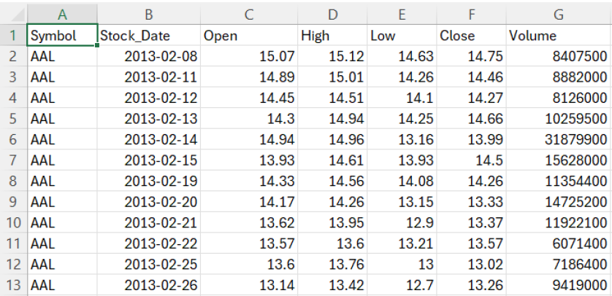
Fact stock

Slide 8
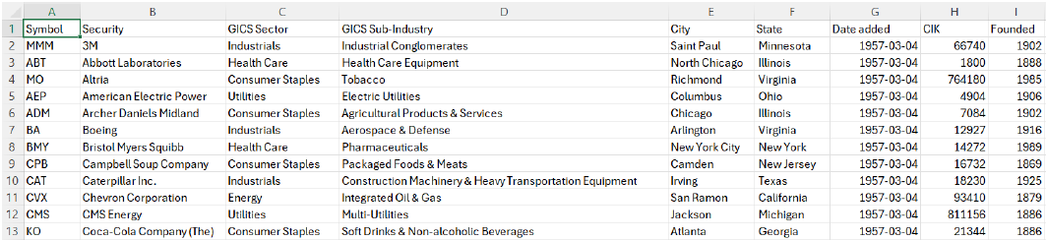
Security

Slide 9
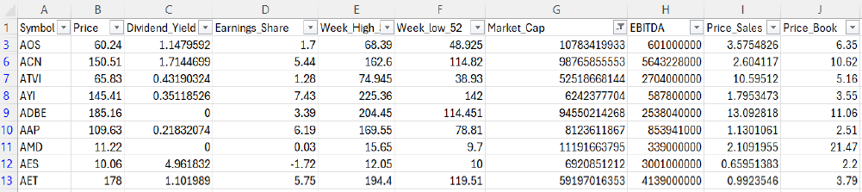
Fact financial

Slide 10
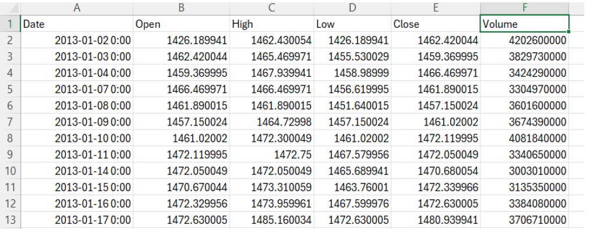
S&P500 Historical Data

Slide 11
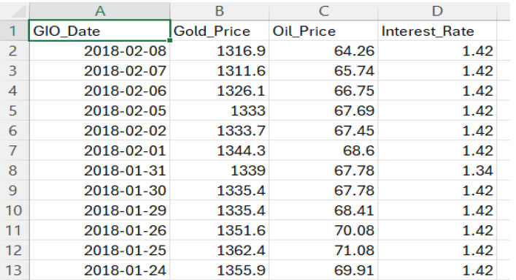
GIO-Fact

Slide 12
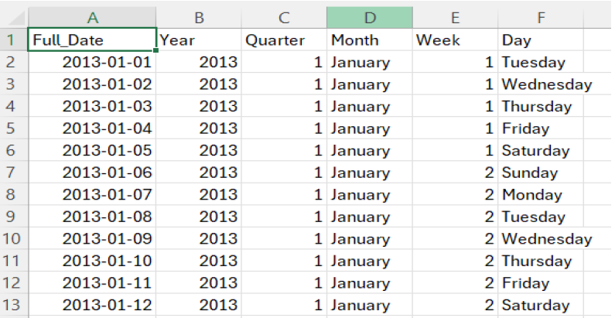
Date Dim

Slide 13
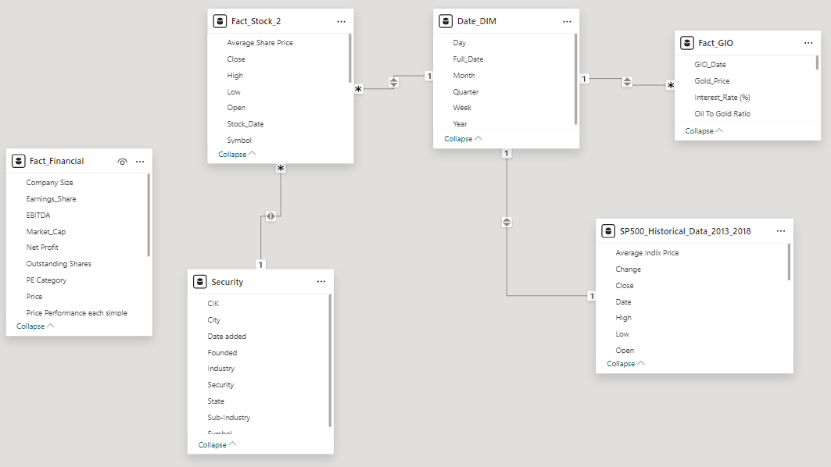
Data model

Slide 14
SQL ANALYSIS

Slide 15
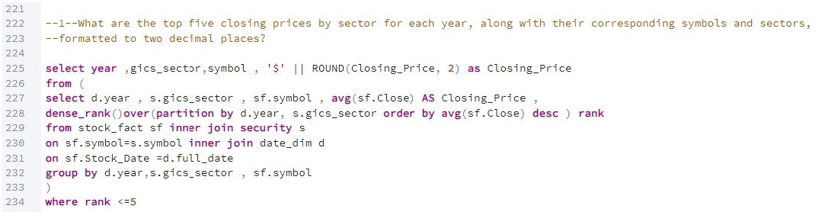
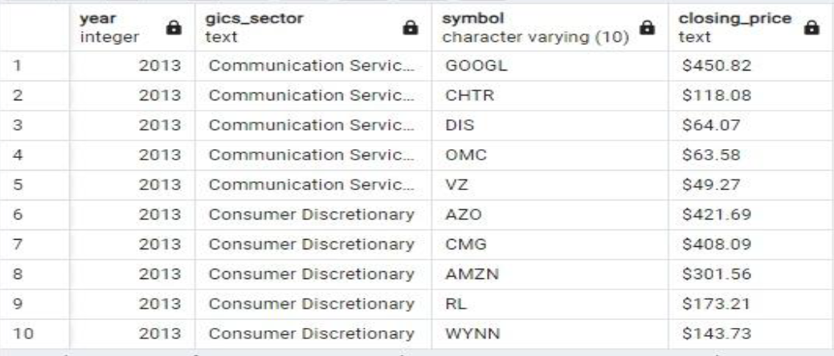
- What are the top five closing prices by sector for each year , along with their corresponding symbols and sectors ?

Slide 16
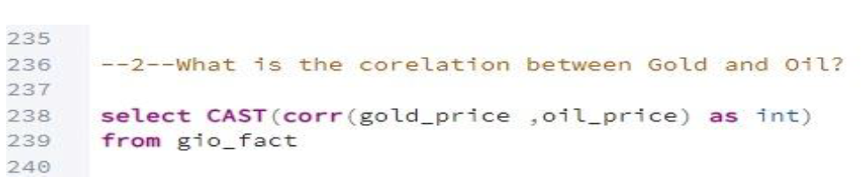
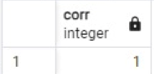
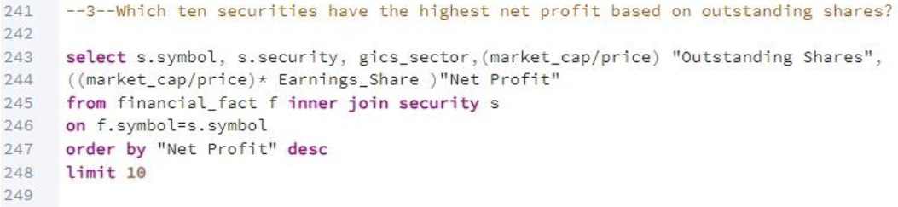
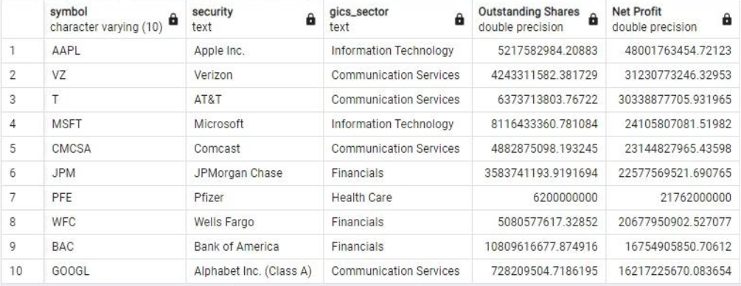
- What is the correlation between Gold Price and Oil Price?
- Which ten securities have the highest net profit based on outstanding shares?

Slide 17
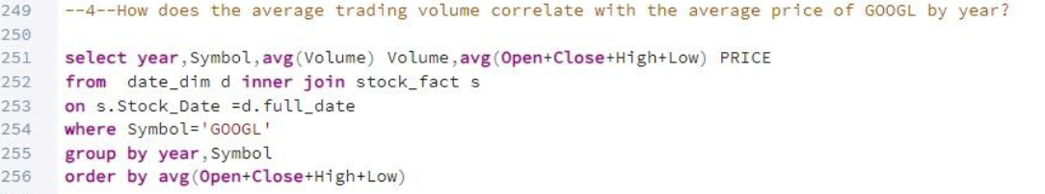
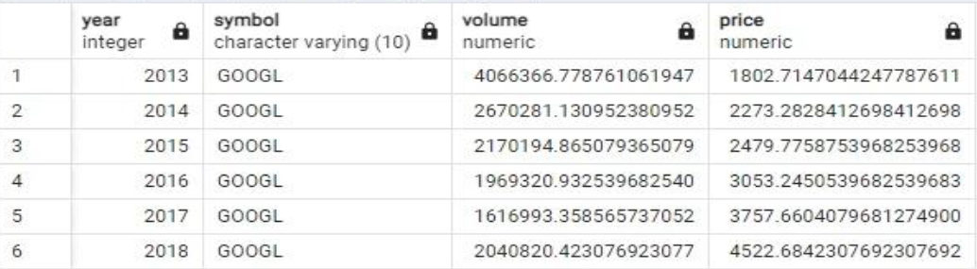
- How does the average trading volume correlate with the average price of GOOGLE by year?

Slide 18
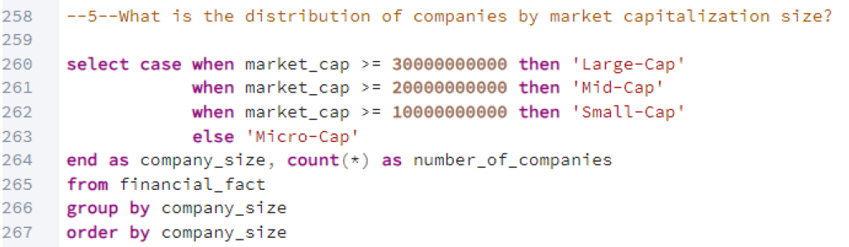
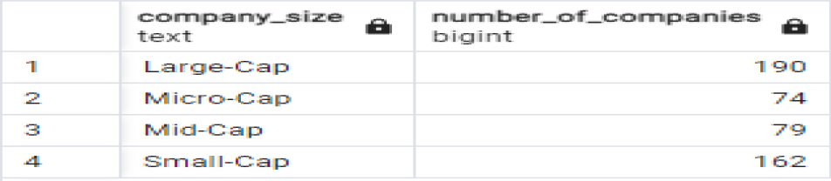
- What is the distribution of companies by market capitalization size?

Slide 19
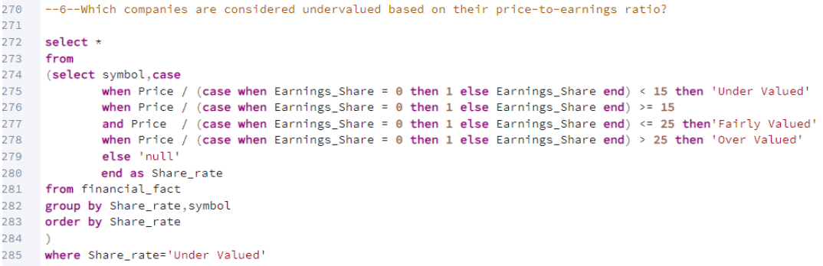
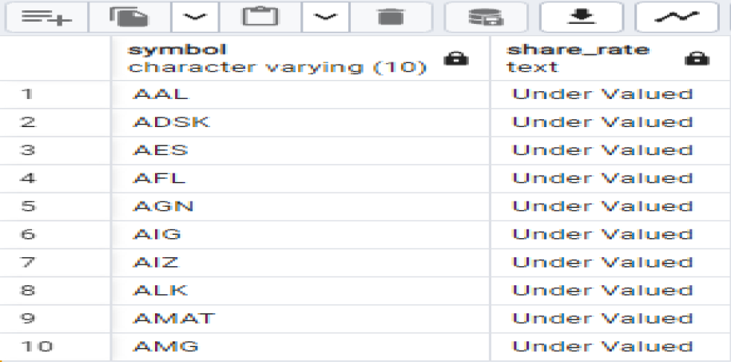
- Which companies are considered undervalued based on their Price-to-Earnings ratio?

Slide 20
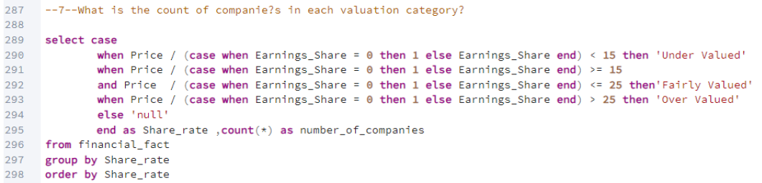
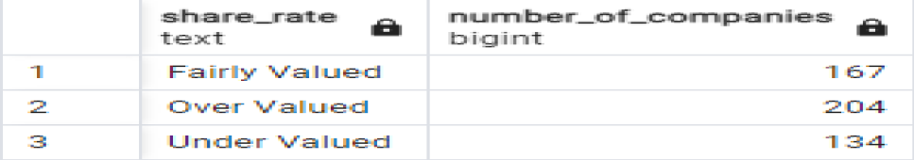
- What is the count of companies in each category?

Slide 21
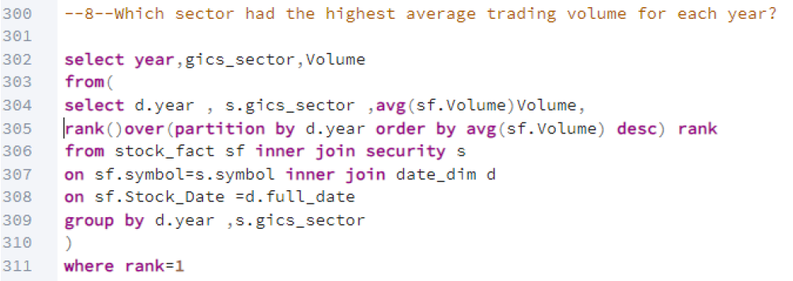
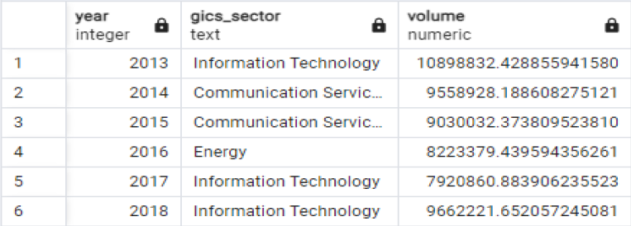
- Which industry had the highest average trading volume for each year?

Slide 22
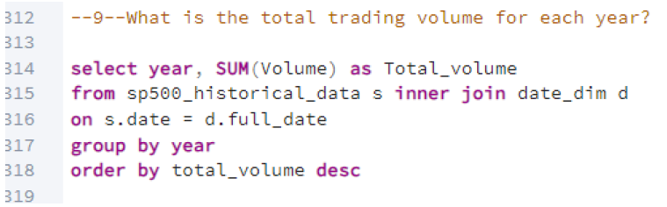
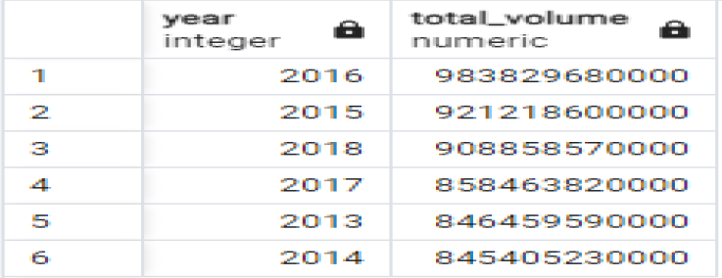
- What is the total trading volume on S&P 500 index for each year?

Slide 23
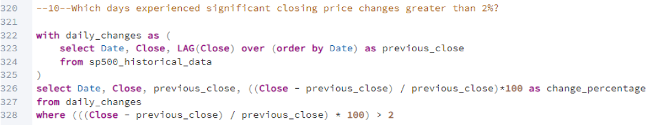
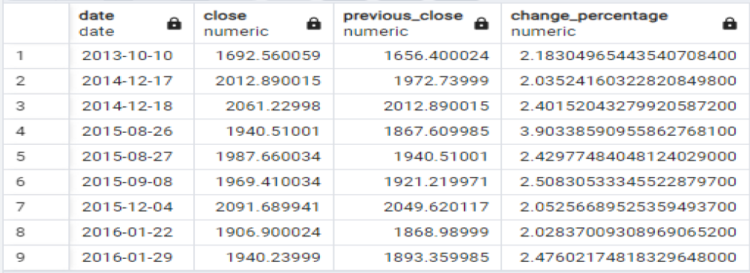
- Which days experienced significant closing price changes greater than 2%?

Slide 24
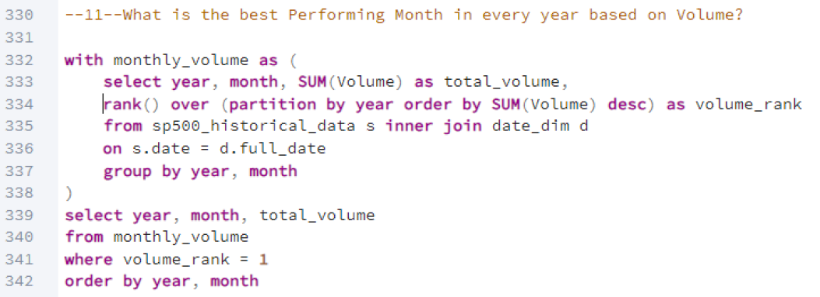
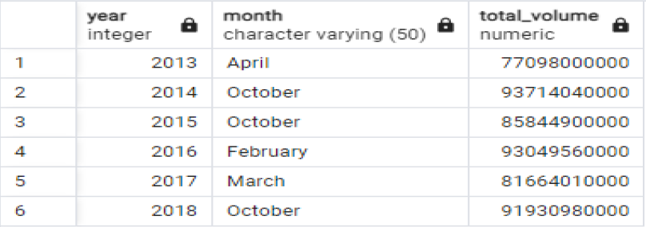
- What is the best performing month in every year based on volume?

Slide 25
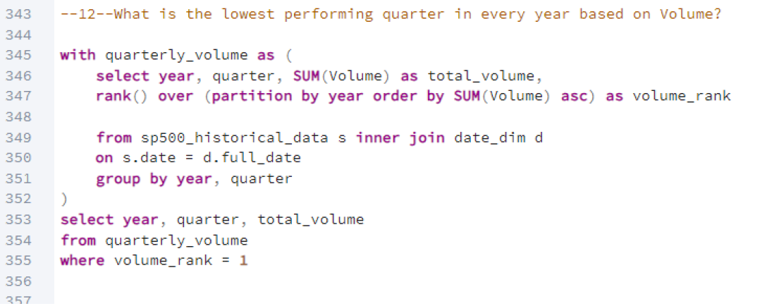
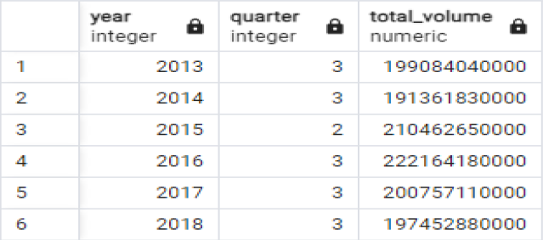
- What is the lowest performing quarter in every year based on volume ?

Slide 26
POWER BI

Slide 27
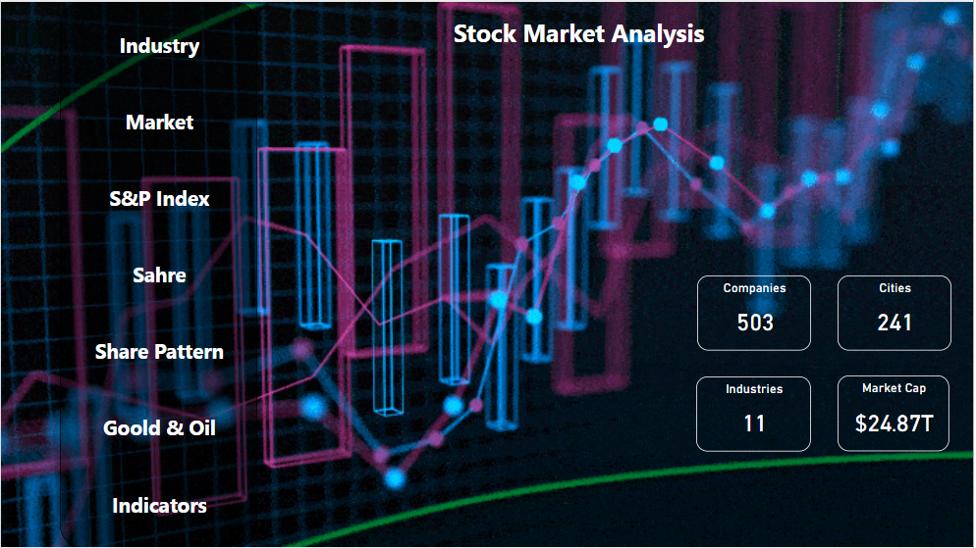

Slide 28
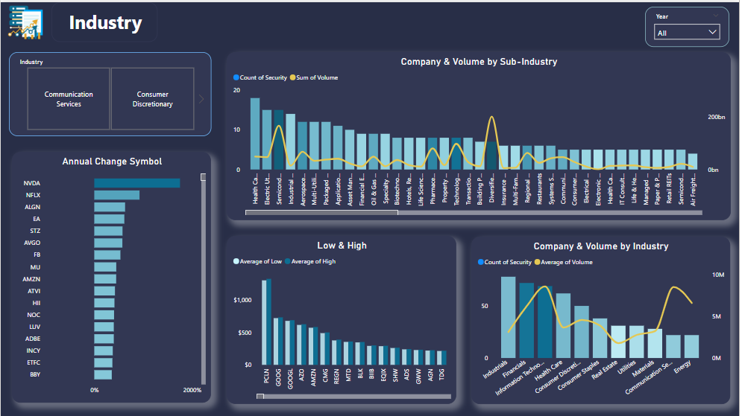

Slide 29
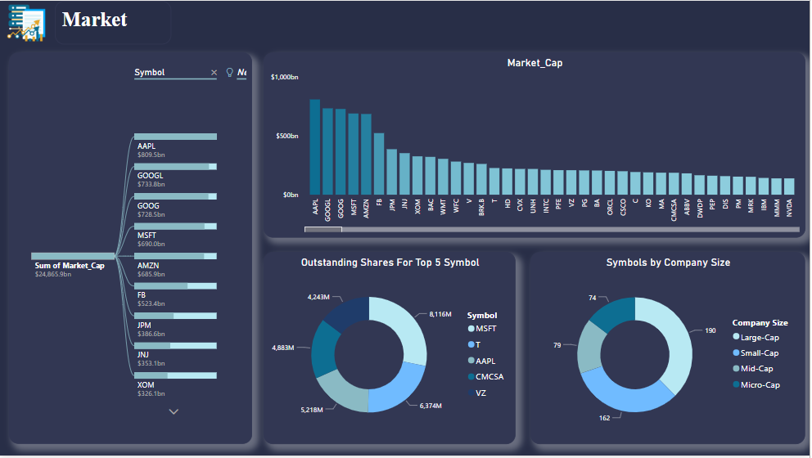

Slide 30
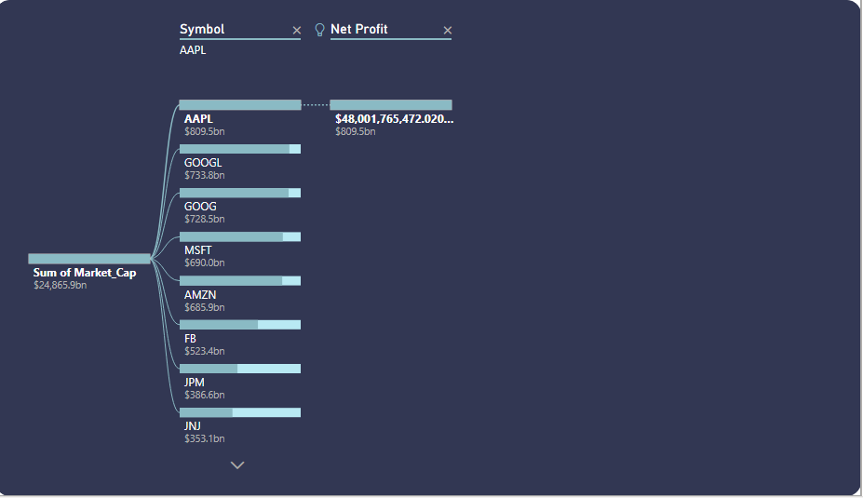
Sum Of Market_Cap

Slide 31
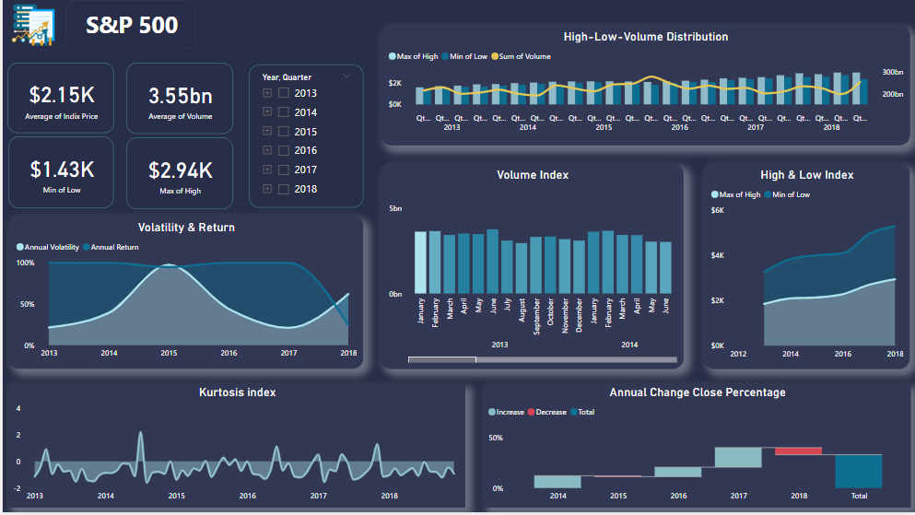

Slide 32
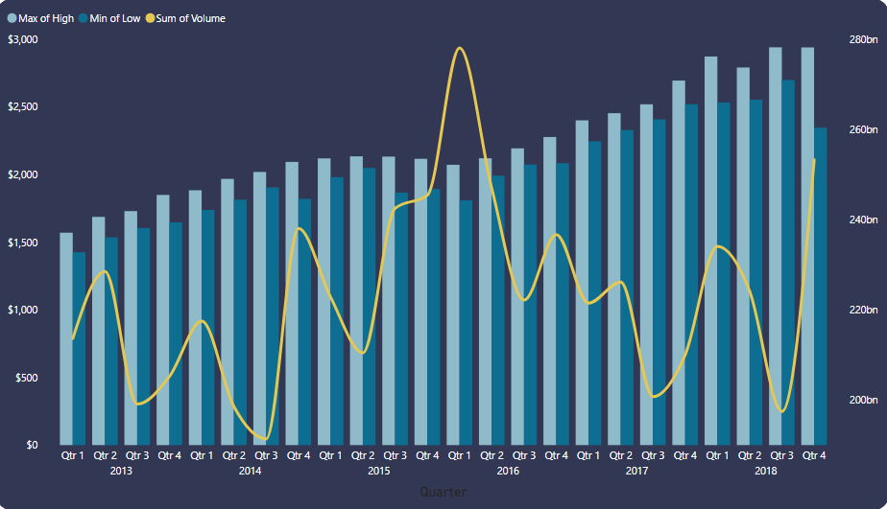
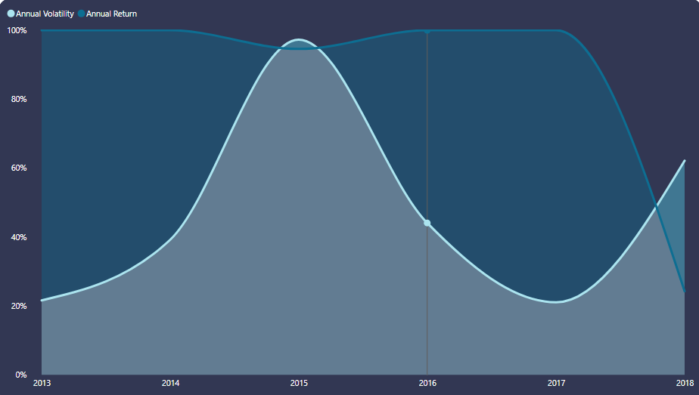
High-Low-Volume Distribution
Volatility & Return

Slide 33
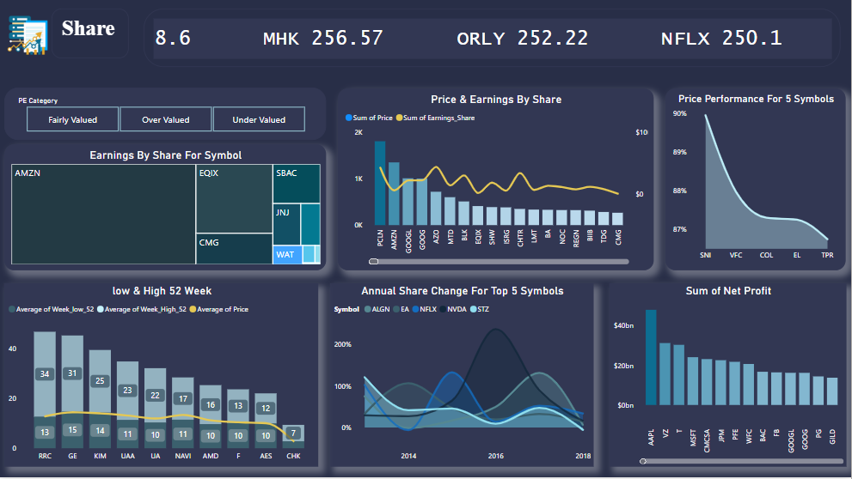

Slide 34
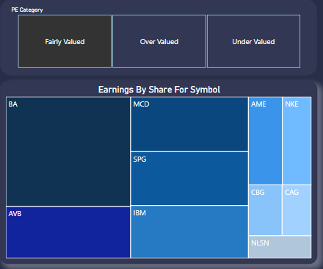
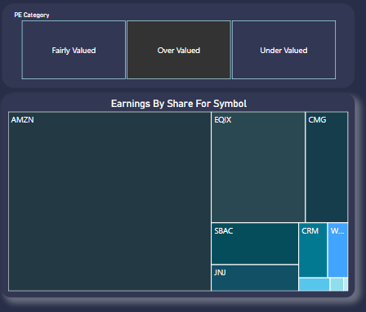
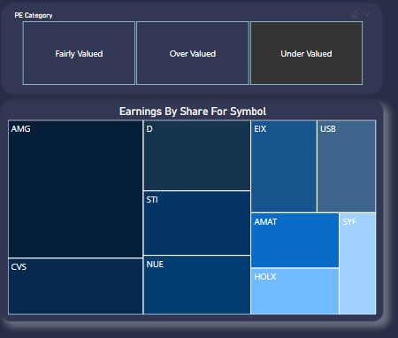
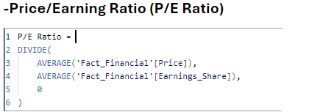
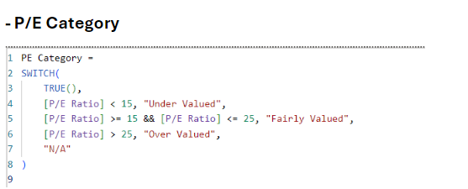

Slide 35
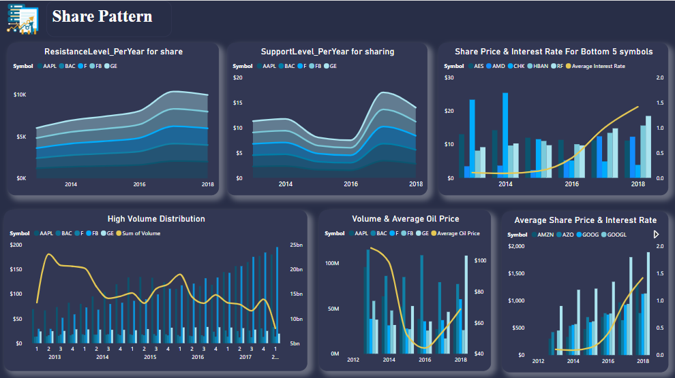

Slide 36
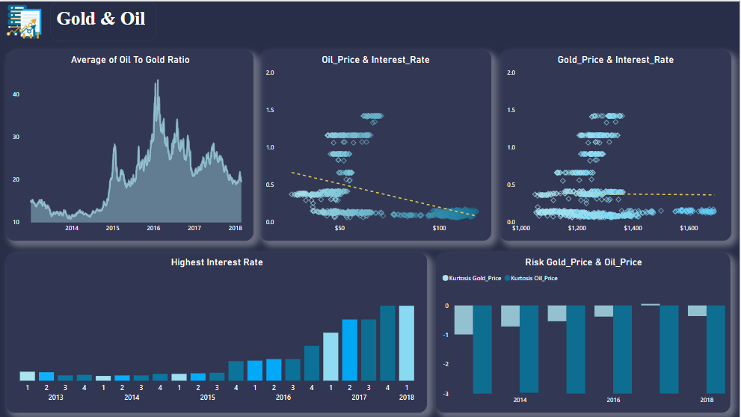

Slide 37
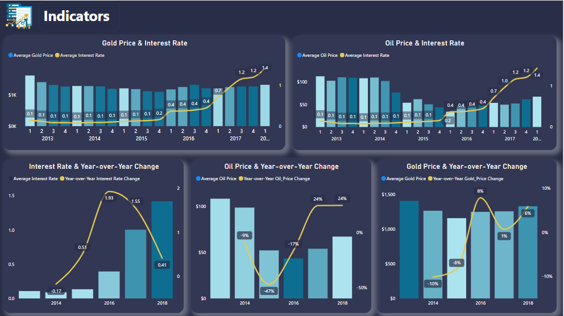

Slide 38


General Recommendation
The stock market can be volatile in the short term. Focus on long-term growth
rather than short-term fluctuations.
Keep up with economic news, earnings reports, and changes in the market
that could affect the S&P 500.

Slide 39









General Recommendation
Focus on Long-term Growth
Beware of Rising Interest Rates
Invest in S&P 500 Index Funds
Diversify Your Portfolio
Monitor Economic Indicators
Stay Updated on Global Conditions
Stay Informed About Economic News
Ensure Safe Storage for Physical Gold
Pay Attention to Oil Prices
Track U.S. Inventory Levels
Consider Gold as a Hedge

Slide 40
Thanks!

